Slide 1
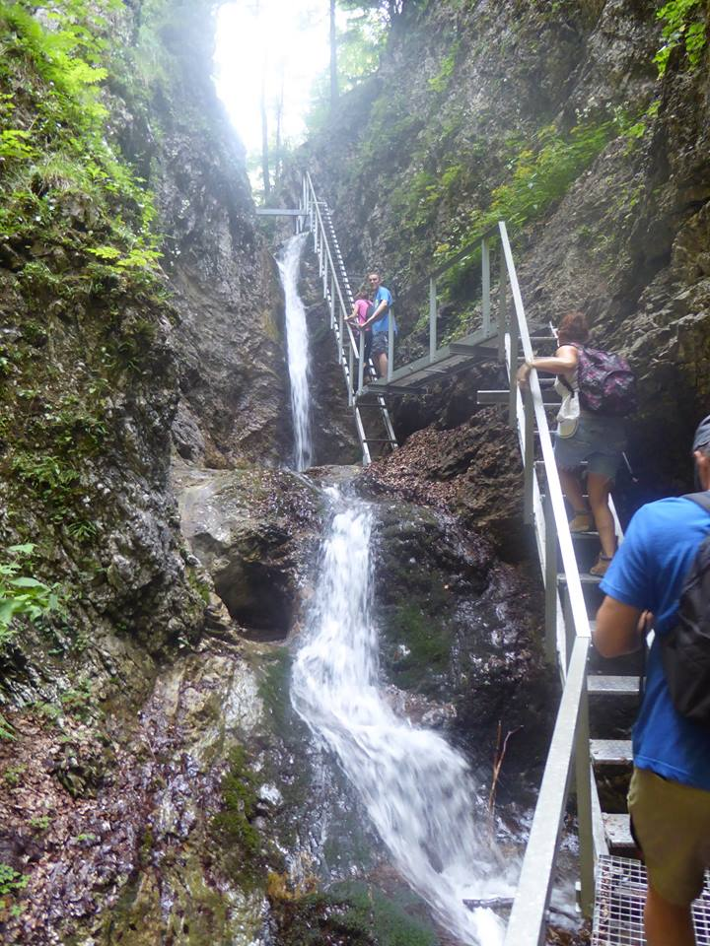
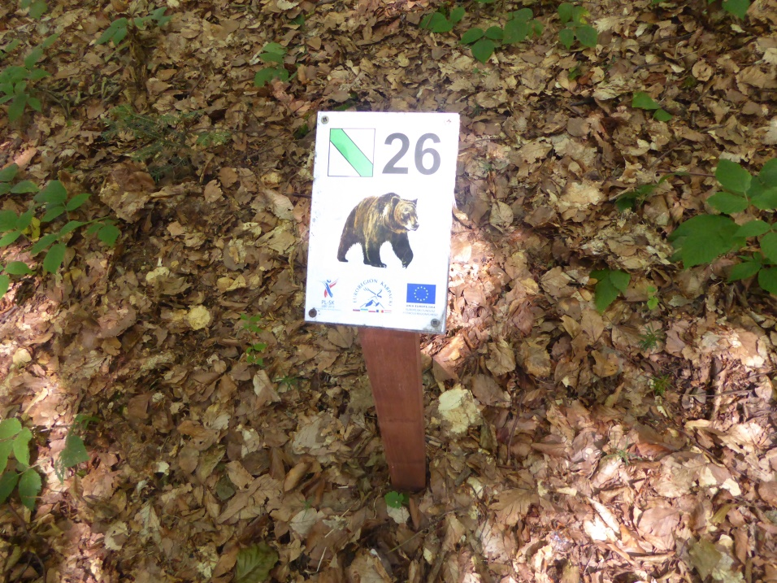
Procedural Environmental Rights in the legislation of the Slovak Republic - instruments enforcing the concept of the Right to a favourable Environment
JUDr. Michal Maslen, PhD.
University of Trnava,
Faculty of Law

Slide 2
Constitutional level
Connection with procedural environmental rights
Art. 26 of the Constitution of the Slovak Republic.
Right to information
Art. 30 of the Constitution of the Slovak Republic.
Right of public participation
Art. 44 of the Constitution of the Slovak Republic.
Right to a favorable environment
Art. 46 of the Constitution of the Slovak Republic.
Right to judicial and other protection
Art. 51 (1) of the Constitution of the Slovak Republic.
Legal restriction of some rights (favorable environment, info about the environment, judicial protection)

Slide 3
Right to information
Art. 26 of the Constitution of the Slovak Republic.
one of the fundamental political rights
(1) The freedom of speech and the right to information are guaranteed.
(3) Censorship is banned.
(4) Restriction - ... if such a measure is necessary in a democratic society to protect the rights and freedoms of others, state security, public order, or public health and morals.
(5) Public authority bodies are obliged to provide information on their activities in an appropriate manner and in the state language. The conditions and manner of execution shall be laid down by law.

Slide 4
Public participation
Art. 30 of the Constitution of the Slovak Republic.
one of the fundamental political rights
guarantees the right to participate in public affairs
directly (to vote on matters of public interest in a national referendum and local referendum)
indirectly (to vote on the election of representatives to the National Council of the Slovak Republic, to the European Parliament, the organs of local self-government).
It only belongs to the individuals, who exercise the right to participate in public affairs and legitimize public authority.

Slide 5
Basis of the Art. 30 of the Constitution
the administration shall establishes conditions
for all citizens
to participate in the public affairs
and decide on public matters
on the basis of direct and concrete expression of
will of all citizens, or particular groups of citizens

Slide 6
The case law in Slovakia
whether it only guarantees direct participation in the exercise of state power through referendums at various stages,
or whether this term also includes other forms of participation in public affairs, in a broader sense,
for example, in the form of commenting the drafts laws of general application.
The case law seems to be generally accepting the opinion said first.
However the second conclusion is rarely and cautiously admitted too. Under the article 2 (1) of the Constitution “State power originates from citizens, who exercise it through their elected representatives, or directly”.

Slide 7
Right to a favourable environment
Art. 44 of the Constitution
Everyone has the right to a favorable environment.
Everyone has the right to timely and complete information about the state of the environment and natural resources.
No one may, in exercising her rights, endanger or cause damage to the environment, natural resources, the wealth of natural species, or cultural monuments beyond the extent set by a law.

Slide 8
Right to a favourable environment
The Constitutional court of the Slovak Republic
Deciding for 23 years now (40 cases related to environmental rights)
Cautious and not willing to interpret this right
Orientated on the procedural conditions of the decision making
Often not responding to the arguments
Missing the proactive approach to this right
Only one opinion from 2003 on the environmental protection as a public interest in the state ruled by law
Czech opinion: impotent right (similar legislation)

Slide 9
The right to a judicial and other protection
ARTICLE 46 OF THE CONSTITUTION
(1) Everyone may claim his right in a manner laid down by law in an independent and impartial court and, in cases laid down by law, at another body of the Slovak Republic.
(2) Anyone who claims to have been deprived of his rights by a decision of a public administration body may turn to the court to have the lawfulness of such decision reviewed, unless laid down otherwise by law. The reviewed of decisions concerning basic rights and freedoms must not, however, be excluded from the competence of the courts.
...
(4) Conditions and details concerning judicial and other legal protection shall be laid down by law.

Slide 10
The right to a judicial and other protection
Quite a strong position in the case-law of the Constitutional court Slovak court
Willing to interpret this right
However still not in the environmental context

Slide 11
The collision of opinions
Constitution guarantees the right to a favorable environment as a fundamental right.
still not to legal entities, possible legal limits
right to a favorable environment
the form of constitutionally declared objective or principle and constitutionally protected value in the objective sense
Article 51 (1) of the Constitution
(1) The rights listed under ... Articles 44 to 46 of this Constitution can be claimed only within the limits of the laws that execute those provisions.

Slide 12
Public participation in environmental matters
Aarhus Convention :
CONVENTION ON ACCESS TO INFORMATION, PUBLIC PARTICIPATION IN DECISION-MAKING AND ACCESS TO JUSTICE IN ENVIRONMENTAL MATTERS
EU is also a member as an entity of international law
ensure compliance with the clauses of the international treaty throughout the whole territory of the Union
also applies to those Member States which have not transposed the international treaty

Slide 13
The fact that the international treaty is a part of the European law
does not automatically mean that it has a direct effect in relation to the national regulations of the Member State
although, on the basis of the case-law of the Court of Justice of the European Union
it may have;
the condition
with regards to its wording, subject and nature, contains a clear and precise right or obligation that is unconditional, i.e. it does not require the adoption of a further instrument for its implementation.

Slide 14
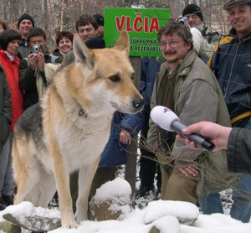
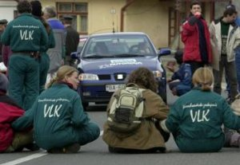
Lesoochranárske zoskupenie vlk

Slide 15
Forest protecting association WOLF
has by June 2009 submitted 120 judicial actions
demanding the reversal of the negative decisions in the matter of return of its right of access to the courts.
the association requested to be party to the administrative proceedings
granting an exception to the systems of protection for brown bear
the Supreme Court of the Slovak Republic has already confirmed 50 of such negative decisions.
But because of the ongoing position of the civic association the Supreme Court of the Slovak Republic decided to stay proceedings and to submit to the Court of Justice under the Article 234 EC for a preliminary ruling the preliminary questions connected with the interpretation of the Aarhus Convention.

Slide 16
Preliminary proceedings
The effects of the obligations contained in the Art. 9 of the Aarhus Convention
especially the right of the civic association to challenge such a decision before the court and object its unlawfulness Under the Art. 9 (1) of the Aarhus Convention:
“Each Party shall ... ensure that any person who considers that his or her request for information ... has been ignored ... has access to a review procedure before a court of law ...”

Slide 17
Whether, in the field covered by the Aarhus Convention
the EU has exercised its powers and adopted provisions to implement the obligations which derive from it.
If that were not the case, the obligations deriving from Aarhus Convention would continue to be covered by the national law

Slide 18
Preliminary proceedings
EU has exercised its powers
and adopted provisions in the field covered by the Aarhus Convention,
the European law would apply
the Court of Justice to determined – EU has explicit external competence under the Art. 175 EC

Slide 19
principle of equivalence
principle of effectiveness
Brown bear - species protected by EU law
it is for the national court - to ensure effective judicial protection in the fields covered by EU environmental law,
to interpret its national law in a way which, to the fullest extent possible, is consistent with the objectives laid down in the Art. 9 (3) of the Aarhus Convention
even in a situation where this article does not have direct effect in the law of the European Union.

Slide 20
Problems in the approach
of the Constitutional court of the SR
The Aarhuss Convention shall be used as an interpretation tool
However even after the decision of the ECJ in 2011
Problems of the NGOs to submit successfully complaints connected with the right to a favorable environment to the Constitutional court of the SR
Doctrine
Right to a favourable environment belongs only to natural persons

Slide 21
Conclusion
Approach of the Concstitutional court of the SR
Unsustainable
Aarhuss Convention as an interpretation tool may affect also the content of other constitutionally guaranteed rights
Right to judicial protection, right to public participation
Legislation in the SR slowly declares the environmental procedural rights to the public concerned
E. g. the Art. 24 (2) of new EIA act – the public concerned has the right to a favorable environment
E. g. the Art. 42 of the Administrative Judicial Code – if the public concerned has a special right under the special legislation it has also the right t a judicial protection

Slide 22
Conclusion
Legislation - slow creation of connection
Between the right to a favorable environment and the right to judicial protection and the right to public participation
The negative approach of the Constitutional court of the SR towards NGOs as legal entities
Unsustainable
Respond inevitable, shall come soon !!!

Slide 23
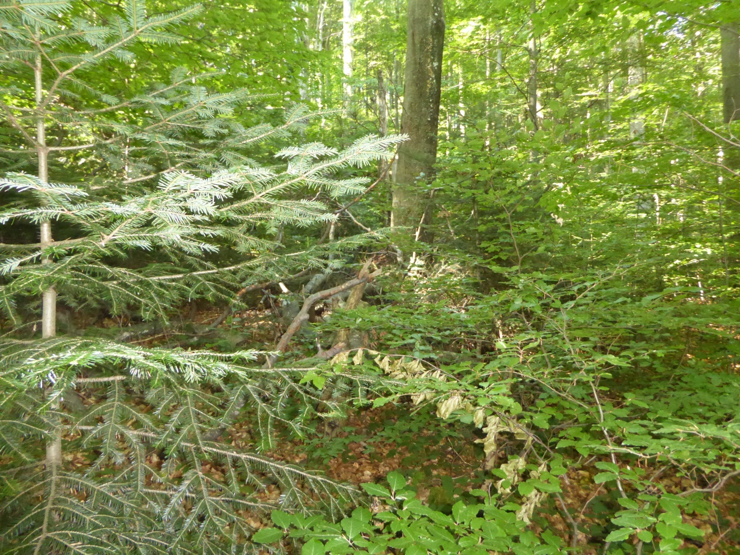
Thank you for your attention !
„Stužica“ primeval beech forest – National park Poloniny

